Slide 1

The Psychology of the
Israeli – Palestinian Conflict
Aaron Ahuvia, PhD
Notes:
I need to remove slides. Even going fast and skipping some slides this was 1 hour 10 minutes

Slide 2
Guess the Poll Results
What percentage of Jewish Americans agreed with this statement:
Do you agree or disagree that Palestinians have a right to live in a secure and independent state of their own?
Agree _____ %
What percentage of Arab Americans agreed with this statement:
Do you agree or disagree that Israelis have a right to live in a secure and independent state of their own?
Agree _____ %
Poll conducted May 2007 by Zogby International. N= 501 in each group.

Slide 3
Are people willing to compromise?
A look at the facts
Section1

Slide 4
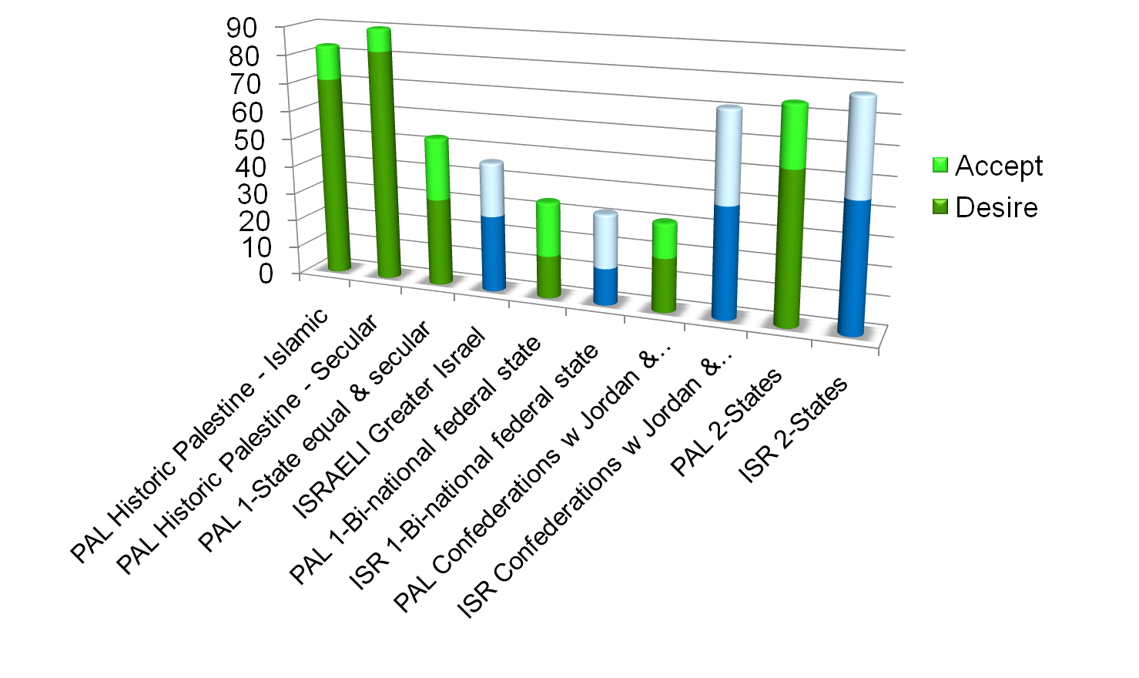
2-State Solution is the
Only Solution
Poll conducted Nov. 2008 – Feb 2009 by Dr. Colin Irwin U. of Liverpool, sponsored by OneVoice.
N = 500 Israel
N = 600 WB & Gaza

Slide 5
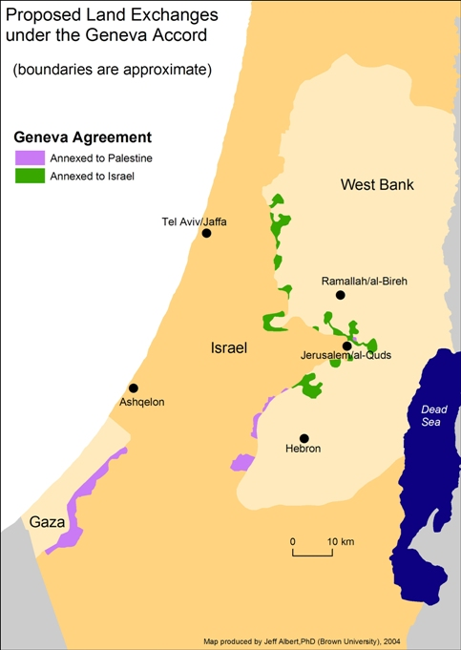
Geneva Accord Map
A two-state solution based on 1967 borders with minor adjustments, demilitarized Palestinian state with Arab East Jerusalem as its capital, and return of Palestinian refugees, primarily to new Palestinian state.

Slide 6
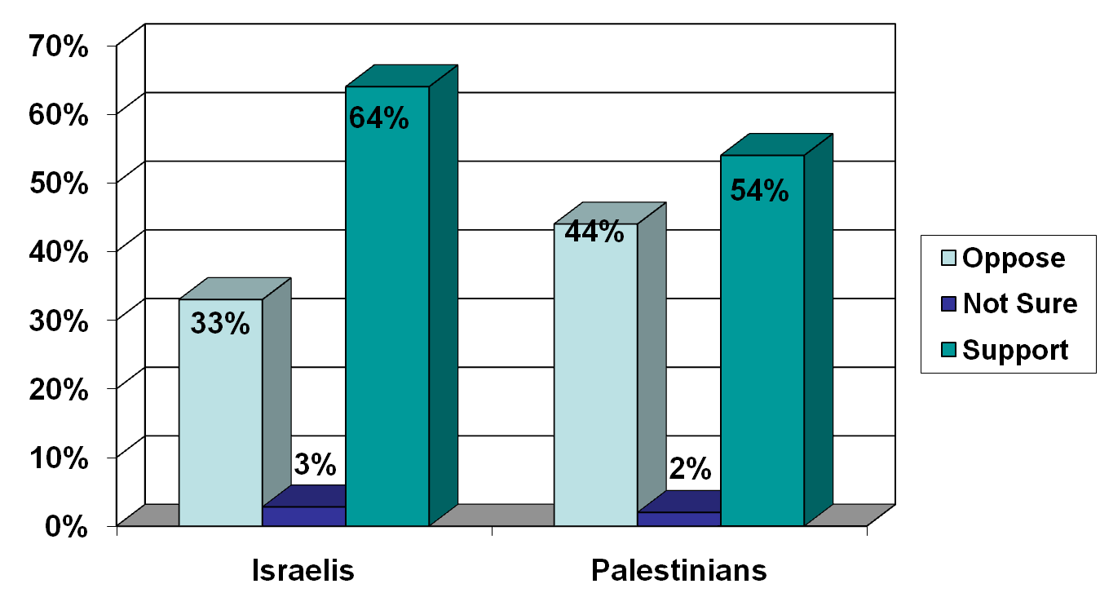
Support for the Terms of the Geneva initiative
A two-state solution based on 1967 borders with minor adjustments, demilitarized Palestinian state with Arab East Jerusalem as its capital, and return of Palestinian refugees, primarily to new Palestinian state.
January 2005
Palestinian Center for Policy and Survey Research and the Harry S Truman Research Institute for the Advancement of Peace.

Slide 7
If Palestinians support two states, why did they elect Hamas?
They believe Israel isn’t serious about negotiations, so what does it matter?
To “throw the bums out”.
Hamas ran good campaigns with qualified candidates.
To show anger at Israel and the US.

Slide 8
Palestinians election results show less support for Hamas than you might think
January 2005: Abbas wins the Palestinian presidency with 62% of the vote.
January 2006: In parliamentary elections, Hamas gains 68% of the seats on the district lists with only 37% of the votes.
Even most Hamas voters don’t support its maximalist stance.
    77% of Hamas voters also support a peace deal.
      Poll published in the Jerusalem Post on Jan. 31, 2006.

Slide 9
Here in America, both Jews and Arabs also support two states.

Slide 10
Remember That Question?
Percentage of Jewish Americans who agree that Palestinians have a right to live in a secure and independent state of their own? 90 %
Percentage of Arab Americans who agree that Israelis have a right to live in a secure and independent state of their own? 88 %
Poll conducted May 2007 by Zogby International. N= 501 in each group.

Slide 11
Jewish Council for Public Affairs Endorses Two States
An umbrella organization representing 14 national Jewish groups and 125 local Jewish community relations councils
"the organized American Jewish community should affirm its support for two independent, democratic, and economically viable states -- the Jewish state of Israel and a state of Palestine-- living side by side in peace and security."
  2-26-2008
Notes:
Here is the list of affiliated organization. The motion passed unanimously with only the Orthodox Union abstaining.
American Jewish Committee http://www.ajc.org National Member Agency American Jewish Congress http://www.ajcongress.org National Member Agency Anti-Defamation League http://www.adl.org National Member Agency B’nai B'rith http://www.bnaibrith.org National Member Agency Coalition on the Environment and Jewish Life http://www.coejl.org JCPA Division Hadassah http://www.hadassah.org National Member Agency Hillel: The Foundation for Jewish Life http://www.hillel.org Affiliated Agency Jewish Labor Committee http://www.jewishlabor.org National Member Agency Jewish Reconstructionist Federation http://www.jrf.org National Member Agency Jewish War Veterans http://www.jwv.org National Member Agency National Conference on Soviet Jewry http://www.ncsj.org/ Affiliated Agency National Council of Jewish Women http://www.ncjw.org National Member Agency National Jewish Coalition for Literacy http://www.njcl.net Affiliated Agency ORT America http://www.ortamerica.org National Member Agency Union for Reform Judaism http://www.urj.org National Member Agency Union of Orthodox Jewish Congregations of America http://www.ou.org National Member Agency United Jewish Communities http://www.ujc.org Affiliated Agency United Synagogue of Conservative Judaism http://www.uscj.org National Member Agency Women's League for Conservative Judaism http://www.wlcj.org National Member Agency

Slide 12
American Jews want the U.S. government to push both sides towards a peace agreement.

Slide 13
US Jews Support an
Activist US Policy
Gerstein | Agne Strategic Communications conducted a survey of 800 American Jews from February 28-March 8, 2009. The survey has a margin of error of +/- 3.5 percent
Notes:
Gerstein | Agne Strategic Communications conducted a survey of 800 American Jews from February 28-March 8, 2009. The survey has a margin of error of +/- 3.5

Slide 14
Israelis want increased U.S. involvement.
Supporters outnumber opponents by 2 to 1.

Slide 15
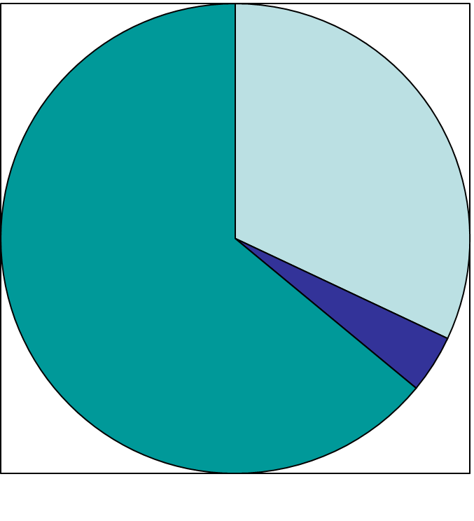
In general, do you support or object to increasing U.S. involvement in the process between Israel and the Palestinians?
Object
32%
Support
64%
Not sure 4%
The public opinion survey was conducted during mid-July 2007 by the New Wave Research Institute (“HaGal HaHadash”). The survey was conducted among a representative sample of 600 Israelis, with a ±4% margin of error.
Israelis

Slide 16
Israelis want negotiations, even with Hamas.
Supporters outnumber opponents by 2 to 1.

Slide 17
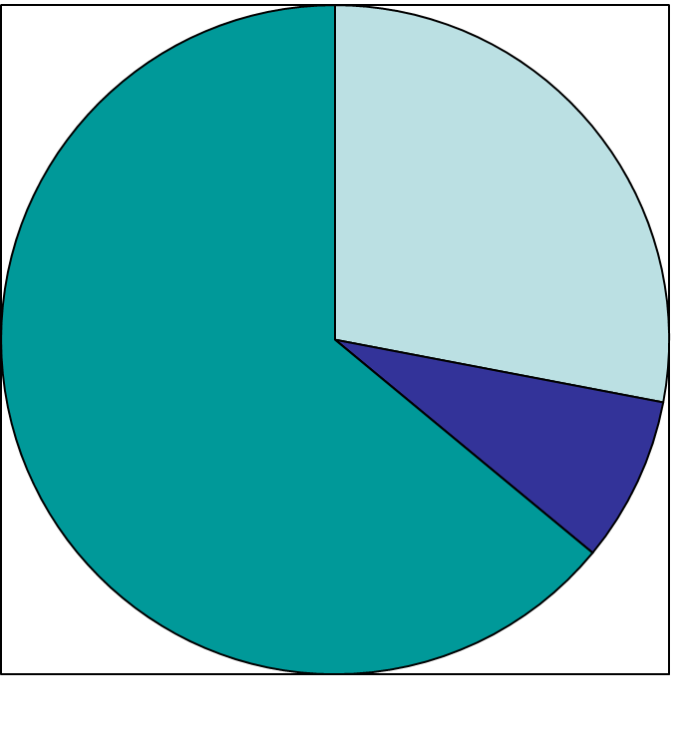
Should the Israeli government hold direct talks with the Hamas government in Gaza towards a cease-fire and the release of captive soldier Gilad Shalit?
Almost half (48%) of Likud voters also supported negotiations with Hamas.
Oppose
28%
Support
64%
Not sure 8%
The public opinion survey was conducted in March 2008 for the Ha’aretz newspaper by Prof. Fuchs of Tel Aviv U.
Israelis

Slide 18
Majorities of Israelis, Palestinians, U.S. Jews, and U.S. Arabs all support a two-state solution.
Section 1 Conclusion

Slide 19
If support for peace is strong, what’s the problem?
Section 2

Slide 20

Would you buy these books?

Slide 21
A basic model of motivation
Motivation
Desirability of outcome
Probability of success
=
x

Slide 22
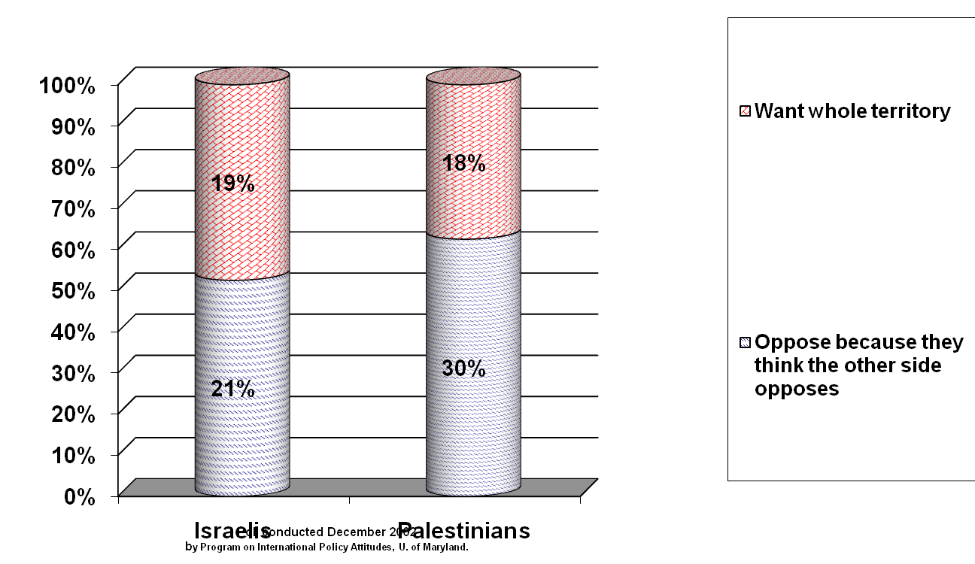
Looking at the minority of each side that opposed a two-state solution in 2002 (40% of Israelis, 48% of Palestinians), why were they opposed?

Slide 23
To American Jews, the big issue is this:
The best predictor of American Jews’ willingness to support compromise is not their religious views, not their general political views, and not even the strength of their emotional attachment to Israel. Rather, it is their agreement with this statement:
  “The goal of the Arabs is not the return of occupied territories but rather the destruction of Israel.”
    Perlman, Joel (2007), American Jewish Opinion about the Future of the West Bank: A Reanalysis of American Jewish Committee Surveys, Working Paper 526, The Levy Economics Institute of Bard College.

Slide 24
What U.S. Jews don’t appreciate...
is that most Palestinians really believe that
Israel is inherently expansionist and
will never settle for any deal that will
leave Palestinians with a viable state.

Slide 25
The issue in the debate between Palestinians is . . .
“Is Israel willing to reach a peace agreement which includes a viable Palestinian state with the Arab neighborhoods of East Jerusalem as it’s capital?”

Slide 26
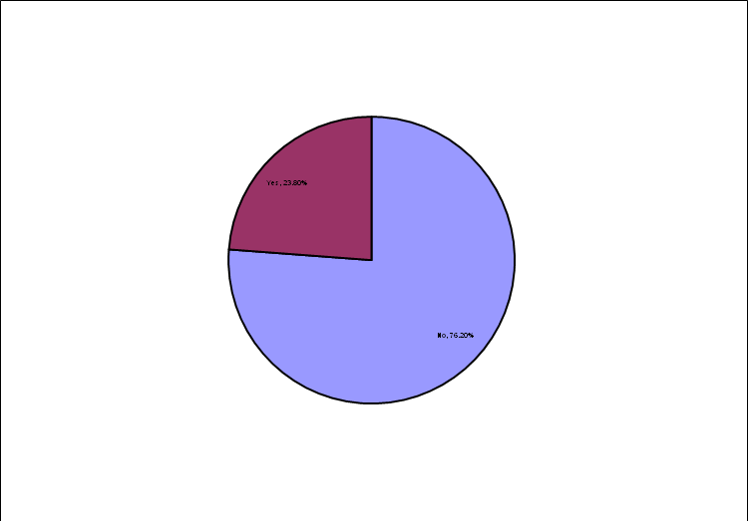
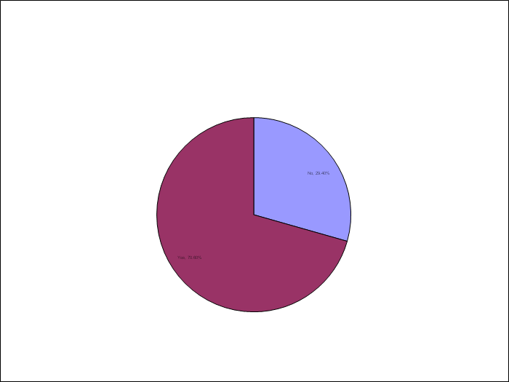
Palestinians don’t see Israel as making serious compromises
Are Palestinians ready to compromise?
“Is there a Palestinian peace partner?”
Is Israel ready to compromise?
“Do Palestinians have a peace partner in Israel?”
Yes 24%
No
30%
Yes 70%
NO 76%
Phone survey of 713 randomly selected Palestinians in the West Bank and Gaza, by Near East Consulting (NEC), August 2006.

Slide 27
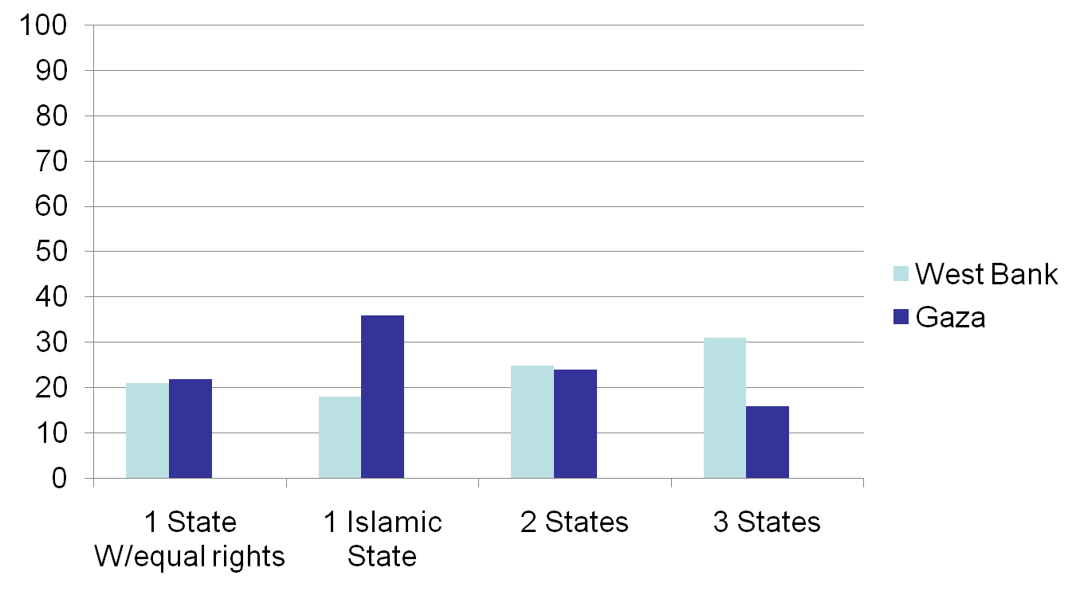
Palestinians don’t believe any solutions are “very realistic”
Percent
Survey by Fafo Institute for Applied
International Studies, Feb & March 2009, N = 1584 in WB,
N= 1476 in Gaza.
Notes:
Fafo carried out the opinion poll in the West Bank on 23 February to 4 March and in the Gaza Strip 3 to 12 March 2009, some five to eight weeks after Israel’s assault on Gaza, which ended 17 January. We carried out interviews at 144 and 132 fieldwork points in the West Bank (including East Jerusalem) and the Gaza Strip, respectively.
In the West Bank, 1584 households were randomly sampled, and in each household one household member aged 18 years or older was randomly selected. As in Gaza, this step of the sampling process relied on a so-called Kish table. 40 of the selected persons (2.5 %) chose not to participate in the poll. In 82 other cases (5.2 %), the fieldwork team could not find the household (the house or apartment was empty, or it had been demolished and the household had moved), or one was unable to interview the selected household member, e.g. because he – it was usually a man – was commuting over a long distance, including to Israel, or because the selected person was mentally unstable or too ill to manage the interview. Altogether 1476, or 93 %, of the selected households and adult individuals were completely or partly interviewed.
Leslie Kish 1965, Survey sampling. New York: Wiley, page 399.

Slide 28
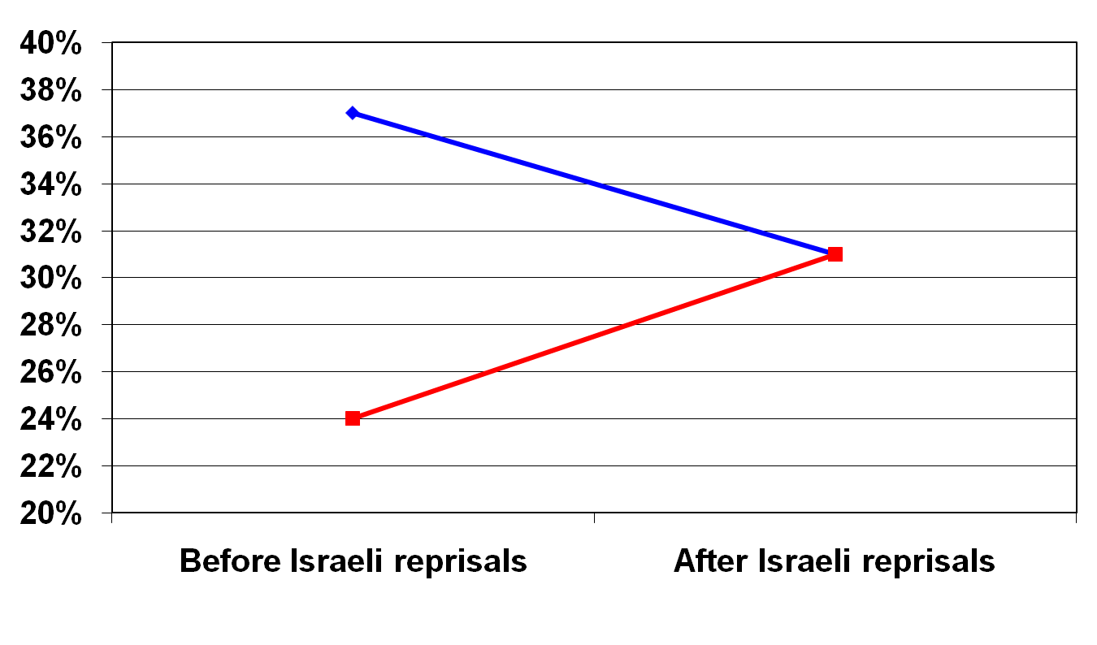
Military Escalation a Boon for Hamas.
Second poll conducted in the two days following an Israeli raid into Gaza that killed 15 Palestinians
Support for Fatah Gov in West Bank falls
Support for Hamas Gov in Gaza rises
Polls conducted among Palestinians living in the West Bank and Gaza in Nov. 2007 and Jan. 2008 by AWRAD. Sample size for both polls was 3,200; margin of error was 2%. AWRAD, a research group funded primarily by the U.S. government and the World Bank, has offices in the Palestinian territories.
Notes:
AMERICANS FOR PEACE NOW: MIDDLE EAST PEACE REPORT
January 28, 2008
Vol. 9, Issue 21
Working for a Secure Israel through Peace
MILITARY ESCALATION IS A BOON FOR HAMAS: Even before the breach of the Gaza-Egypt border, the escalation in cross-border attacks between Gaza and Israel had pumped up public support for Hamas. This was the principle finding of a poll conducted in the West Bank and Gaza by the Ramallah-based AWRAD research center, when compared with an AWRAD survey from shortly before the November Annapolis peace conference. The new poll was in the field on January 18th and 19th – beginning the day after an Israeli attack in Gaza that killed 15 Palestinians.
In its survey analysis, AWRAD concluded that the poll confirmed “the hypothesis that military approaches and violence reinforce hard-line positions, and negatively influence the lot of all parties involved, especially the credibility of the president of the PNA and his government.”
In the most recent poll, 31% of Palestinians evaluated the Palestinian cabinet in the West Bank headed by Prime Minister Salam Fayyad positively, compared with 37% in November. 31% evaluated the Palestinian cabinet in Gaza headed by Hamas leader Ismail Haniyah positively, compared with 24% in November.
Asked to name a candidate to support for the Palestinian presidency in November, incumbent President Mahmoud Abbas topped this list with 22%. In the latest poll, Abbas’ support dropped to 16%, behind Haniyah (17%), who had come in third place in November’s rankings (with 14%). When Haniyah was matched in a one-on-one contest with Abbas, 39% said that they would vote for Abbas, while 27% chose Haniyah, a 12-point gap. This too reflected a drop in support for the Fatah candidate: in November’s poll, Abbas enjoyed a 24-point margin in the hypothetical contest.
AWRAD also noted that support for firing rockets from Gaza into Israeli territories nearly doubled from 27% in a December poll to 48% in January.
Nevertheless, the AWRAD poll demonstrated continued strong support for a negotiated two-state solution and opposition to attacks on Israeli civilians. 63% of Palestinians support a two-state solution. A large plurality of 42% identified negotiations as the best means to end the occupation and establish a Palestinian state, while 19% favored a peaceful popular uprising. 28% chose “operations against the Israeli military and settlers.” 4% favored “operations against civilians in Israeli cities.”
The visit of President George W. Bush to Israel and the West Bank received very low marks among Palestinians. Only 21% think that Bush is serious to any extent about establishing a Palestinian state. 65% believe that his visit will reinforce the Israeli occupation. 82% believe that the visit will not put a stop to Israeli settlement activities. (AWRAD, 1/23/08)

Slide 29
The problem is not that either side doesn’t want peace.
The problem is that both sides are convinced that the other side doesn’t want peace.
Section 2 Conclusion

Slide 30
If polling data shows that both sides want peace, why are people so sure that the other side is only pretending to be interested in a deal?
Section 3

Slide 31
Psychological Biases
Threats draw disproportionate attention.
Availability heuristic
  We think things are frequent if we can remember many examples of them.

Slide 32
Category Structure Complexity Bias
People
My In-group
Subgroup 1
Subgroup 2
Subgroup 3
Me and my crowd
Subgroup 4
An out-group I interact with a lot
Subgroup 1
An out-group I have little direct interaction with
The other guys 1
The other guys 2
The other guys etc.
Subgroup 2

Slide 33
How Many Jews Categorize Religious Groups
People
Jews
Christians
Muslims
Orthodox
Recon-
structionist
Reform
Those
Spiritual
People
Conserv-
ative
Liberal
Churches
Born-
Again
Christians
Muslims
Me and My
Friends
That
Other
Group 1
That
Other
Group 2
That
Other
Group 3
That
Other
Group N

Slide 34
Categorization Biases for Baptists
People
Christians
Jews
Muslims
Catholic
Methodist
Baptist
Pentecostal
Anglican
My Jewish
neighbor
Orthodox
in the hats
Muslims
Southern
Baptist
American
Baptist

Slide 35
The Fundamental Attribution Error
Our own behavior is a response to our situation; the behavior of others is caused by their internal traits.
How did you choose your major?
  Nisbett, Caputo, Legant, and Maracek (1973).
Essays on Castro
    -- Jones and Harris (1967).
Notes:
Nisbett, RE, Caputo, C, Legant, P, & Marecek, J. Behavior as seen by the actor and as
seen by the observer. Journal of Personality and Social Psychology, 1973, 27, 154-
164.

Slide 36
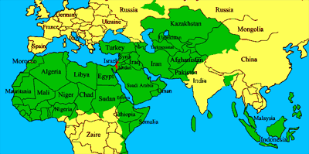
Framing the Conflict
Israelis see themselves as the “little guy.”
Red= Israel; Green = Arab or Muslim countries
  Map from the website of the Israel Project.

Slide 37

Framing the Conflict
Palestinians see themselves as the “little guy.”
Whereas Israelis see the “Arab-Israeli conflict,” supporters of the Palestinians see the “Israeli-Palestinian conflict.”

Slide 38
Trusting Confirming Information

Slide 39
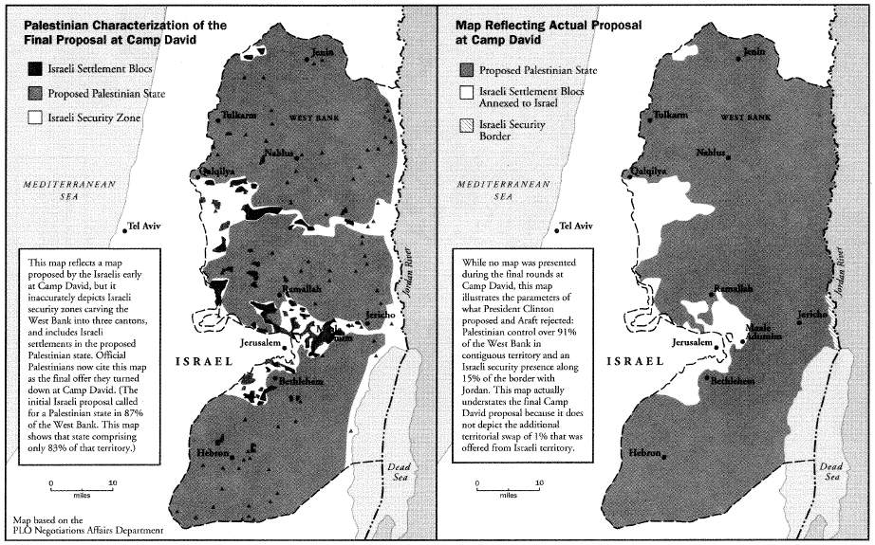
Conflicting Versions of the Final Israeli Offer at Camp David
Map from The Missing Peace, by Dennis Ross

Slide 40
Claims and Counter Claims About West Bank Property
Debates about who owned what
  The distinction between private personal property and state lands in the West Bank
Secret Israeli government database leaked shows that 30% of all settlement land is private Palestinian property

Slide 41
Two key issues in assigning moral responsibility
Outcomes
Intentions

Slide 42
People have inherent psychological biases that lead them to overestimate the prevalence of malevolence.
Section 3 Conclusion

Slide 43
Is it all just in our heads?
Section 4

Slide 44
The Hamas Charter
The Hamas founding charter contains in its opening paragraph the following declaration:
“Israel will rise and will remain until Islam eliminates it as it had eliminated its predecessors.”
This is followed, in article seven, with the exhortation that
“the time will not come until Muslims will fight the Jews (and kill them); until the Jews hide behind rocks and trees, which will cry: O Muslim! There is a Jew hiding behind me, come on and kill him!”
The charter goes on to advocate the creation of an Islamic state, aiming
“to raise the banner of Allah over every inch of Palestine.”
Notes:
As quoted by Jonathan Spyer in Haaretz, May 27, 2005

Slide 45
The Likud Party Platform
Below are the most recent official written statements from Likud
that address these issues, from the Knesset website. The most
recent Likud party constitution does not explicitly address these issues.
Self-Rule
  The Government of Israel flatly rejects the establishment of a Palestinian Arab state west of the Jordan river.
  The Palestinians can run their lives freely in the framework of self-rule, but not as an independent and sovereign state.
Settlements
  The Jewish communities in Judea, Samaria, and Gaza are the realization of Zionist values. . . . The Likud will continue to strengthen and develop these communities and will prevent their uprooting.

Slide 46
Terrorism
The Israeli Clinching Argument
Attacks on civilians and attacks inside the green line
  “Extreme violence is incompatible with moderate aims."
Hebron Massacre 1929
  On August 23, 1929, a planned attack against the Jewish population in Hebron killed 64 men, women, and children and led to the expulsion of the surviving Jewish community.
    Baruch Kimmerling, Professor of Sociology at theHebrew University of Jerusalem, and Joel S. Migdal, Professor of International Studies at the University of Washington, in their book entitled The Palestinian People: A History, p. 91-92.

Slide 47
Settlement Expansion
The Palestinian Clinching Argument
“It’s like two people negotiating about a piece of cake. One side is negotiating, looking at the cake, while the other side is eating it.”
  Dr. Mustafa Barghouthi, September 2002.
“We'll make a pastrami sandwich of them. . . . We’ll insert a strip of Jewish settlements in between the Palestinians, and then another strip of Jewish settlements right across the West Bank, so that in 25 years’ time, neither the United Nations nor the United States, nobody, will be able to tear it apart.”
  Ariel Sharon, 1973.
    (As quoted by Winston S. Churchill III (journalist, former member of Parliament, and grandson of the British prime minister) at the National Press Club, October 10, 2001, recalling his conversation with then General (res.) Ariel Sharon in 1973).

Slide 48
It is not all in our heads. Both sides do things that breed distrust.
For both sides, stopping these negative actions is a primary security imperative.
Section 4 Conclusion

Slide 49
We need to act now!
Section 5

Slide 50
The status quo harms Israel
We're getting perilously close to closing the window on a two-state solution . . .. If the Jewish settlers continue with their ''natural growth'' to devour the West Bank, it will also be effectively off the table.
  Thomas Friedman, Jan 25, 2009
"If the day comes when the two-state solution collapses. . . the State of Israel is finished."
  Former Israeli Prime Minister Ehud Olmert

Slide 51
Palestinian moderates need to show real progress
Palestinian security services
  A joint US/Israeli/Palestinian program trains Palestinian security services to keep order in the West Bank and combat Hamas or other radical groups.
  The goal is a 10,000 man, highly trained, force.
  Their mission is to "create a Palestinian state."
"There is perhaps a two-year shelf life on being told that you're creating a state, when you're not."
  Lt. General Dayton, U.S. security coordinator for Israel and the Palestinian Authority, May 10, 2009.
Notes:
US General Builds A Palestinian Army
Robert Dreyfuss
The Nation (Blog)
May 10, 2009 - 12:00am
http://www.thenation.com/blogs/dreyfuss/434494/us_general_builds_a_palestinian_a...
Last Thursday, in what was billed as his very first on-the-record
address, Lt. Gen. Keith Dayton, U.S. security coordinator for Israel and
the Palestinian Authority, spoke to the 2009 Soref Symposium organized
by the Washington Institute for Near East Policy. WINEP, of course, is
the chief thinktank for the Washington-based Israel lobby.
And in his talk, Gen. Dayton delivered an important warning.
First, the background. For the past three and a half years, Dayton has
lived and worked in Jerusalem and across the West Bank, overseeing the
creation of three Palestinian battalions of troops, hand-picked in the
West Bank, trained at an academy in Jordan, and then deployed in the
occupied territory.
The three 500-man battalions are intended to grow, to as many as ten
battalions. Their mission, he said, is to "create a Palestinian state."
Recognizing that many in the WINEP audience were not exactly enamored
with the idea of an independent Palestine, Dayton told his audience: "If
you don't like the idea of a Palestinian state, you won't like the rest
of this talk."
Each recruit is vetted by US security forces (i.e, the CIA), then vetted by
Shin Bet, the domestic intelligence arm of Israel, and then by Jordan's
super-efficient intelligence service, before they begin their training
in Jordan. Dayton made it quite clear that the Palestinian units thus
trained are primarily deployed against two targets in the West Bank:
against criminal gangs, and against Hamas.
So far, they've received $161 million is US funding.
Dayton described how, during the Israeli assault on Gaza last December
and January, the West Bank remained quiet -- even though some analysts
were predicting an upsurge of sympathy for Hamas, which controls Gaza,
along with violence, even a third intifada. "None of these predictions
came true," said the general, who added that the Palestinian battalions
allowed peaceful demonstrations of solidarity with Hamas, but kept the
lid on violent actions. Israel, he said, "kept a low profile," and not a
single Palestinian was killed in the West Bank during the three-week
carnage in Gaza.
Now for the warning. Recognizing that by organizing and training
thousands of Palestinian troops, professionally led, he is creating in
effect a nationalist army, Dayton warned the 500 or so WINEP listeners
that the troops can only be strung along for just so long. "With big
expectations, come big risks," said Dayton. "There is perhaps a two-year
shelf life on being told that you're creating a state, when you're not."
To my ears, at least, his subtle warning is that if concrete progress
isn't made toward a Palestinian state, the very troops Dayton is
assembling could rebel.
Dayton was responding to a question from Paul Wolfowitz, the
neoconservative former deputy secretary of defense, who now hangs his
hat at the neocon-dominated American Enterprise Institute. "How many
Palestinians see your people as collaborators?" Wolfowitz asked. In
answering Wolfowitz, the general acknowledged that Hamas and its
sympathizers accuse the Palestinian battalions of being "enforces of the
Israeli occuption." But he stressed that each one of them believes that
he is fighting for an independent Palestine. The unstated message: the
United States and Israel had better deliver. Thus the two year warning.
Which, to me, sounds spot on with the Obama administration's timetable.
One more thing: General Dayton signed up for another stint in the West
Bank. And how long did he agree to serve? Yes--two years.

Slide 52
Take aways from today’s talk
Section 6

Slide 53
In Sum
Motivation =
Desirability of outcome
x
Probability of success
Too much focus
Not enough focus

Slide 54
The false belief that the other side is not open to peace is the largest impediment to peace.
To reduce this harmful and false belief, we must
  reduce the actions on both sides that provide evidence for it.
  work to provide accurate information to both sides, which allows them to see the other in more complex, accurate, nuanced, and hopefully empathetic terms.

Slide 55
What We Need to Do
Supporters of each side need to look first
at the behavior of their own side, and
work to stop actions that lead to distrust.

Slide 56
American Jews support a freeze on all settlement expansion, even if there is no direct Palestinian quid pro quo.
Supporters outnumber opponents by more than 2 to 1.

Slide 57
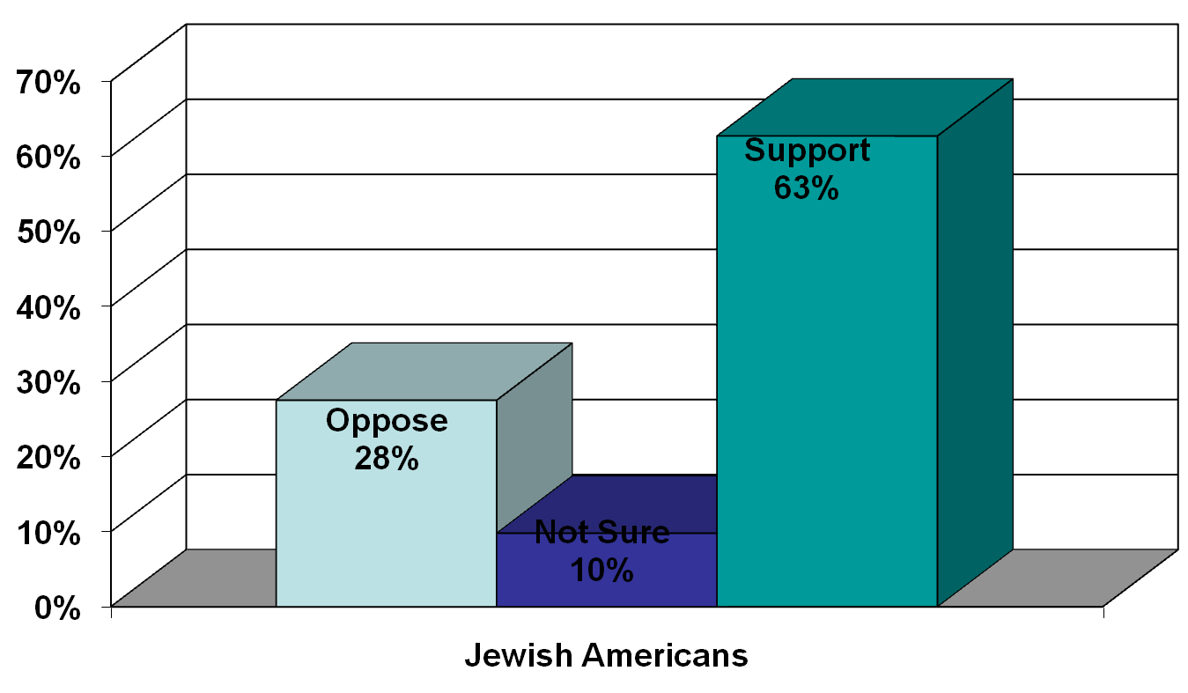
Do you support or oppose a freeze on all Israeli settlement expansion in the West Bank and Gaza?
Poll of 500 U.S. Jews by Zogby International for APN in 2004

Slide 58
What we need to do
Supporters of each side need to look first at the behavior of their own side, and work to stop actions that lead to distrust.
Build a strong political organization that can balance the influence of the hard-right on our leadership.

Slide 59
Brit Tzedek v’Shalom
45,000+ supporters (and more, after you join!)
38 local chapters
Offices in Washington and Chicago
Notes:
We don’t have offices in Boston!

Slide 60
Real Success: Results That Impress Our Critics
In Which I Eat Crow
Ron Kampeas, April 2, 2009
(In a previous article Kampeas had “teased” Jewish peace groups) “for their Horshack-like glee at having signed up 32 co-sponsors in the U.S. House of Representatives for a resolution urging "aggressive" U.S. engagement in the Israeli-Palestinian peace process. …I pretty much said "don't call me until you get to 100.“
“Well, they've topped 100 – 101 . . . And at a time that an Israeli government that wants to slow-pedal the peace process has just been installed.”
Notes:
More than one-third of the Senate--36 cosponsors--for the 2007 Feinstein/Lugar resolution, which calls for active U.S. engagement to resolve the Israeli-Palestinian conflict, including the appointment of a special envoy for Middle East peace, through thousands of faxes, phone calls, emails, and in-person advocacy meetings.
Brit Tzedek helped secure 135 House signatories to the Ackerman-Boustany letter to Secretary Rice. The letter expresses support for the Annapolis conference as a “critical opportunity” to reinvigorate the Israeli-Palestinian peace process.

Slide 61

What you can do
Join Brit Tzedek v’Shalom
Sign on to our pledge campaign “We’ve got your back, Mr. President.”
Big conference Oct. 25-28 in DC.
Driving Change
Securing Peace

